Slide 1

SQL Case Study - Marketing Analysis
- Akshay Sowdari

Slide 2
Overview
Assessing the Success of Sustainable Clothing Co.'s Marketing Campaigns
Sustainable Clothing Co." is a company with a profound commitment to combining environmental sustainability and fashion. They've entrusted us with the task of assessing the impact of their marketing campaigns. Our primary aim is to dig deep into the data and extract valuable insights. These insights will not only provide a clear understanding of the effectiveness of their marketing initiatives but also help us address crucial questions that are instrumental in measuring the success of their efforts. In essence, our mission is to evaluate and interpret the data to ensure that Sustainable Clothing Co.'s marketing endeavors are making a significant and positive impact, aligning perfectly with their sustainability-focused vision and the world of fashion.

Slide 3
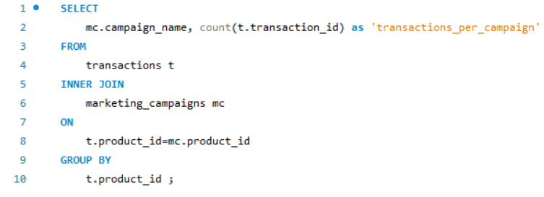

Insights
1. Transaction Insights: We're delving into the number of transactions completed during each marketing campaign. Understanding the transaction count provides a critical measure of campaign performance.

Slide 4
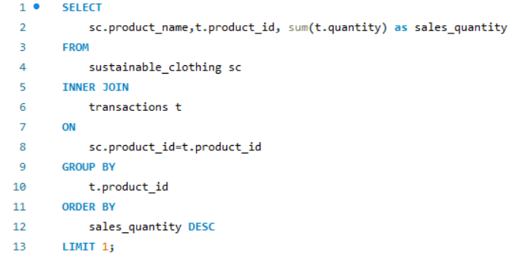

2. Product Insights: Identifying the product with the highest sales quantity is crucial to pinpointing trends and best-sellers.

Slide 5
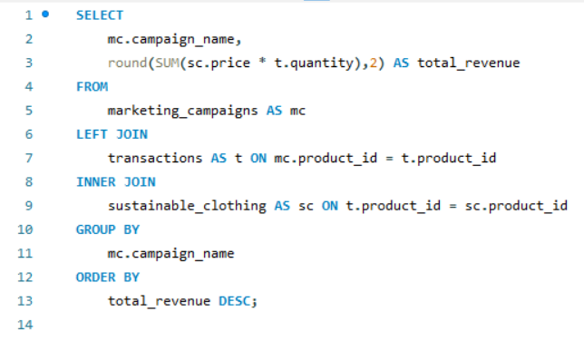
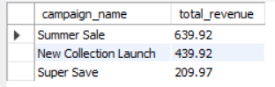
3. Campaign Revenue: We're meticulously crunching numbers to reveal the total revenue generated from each marketing campaign, helping us understand their financial impact.

Slide 6
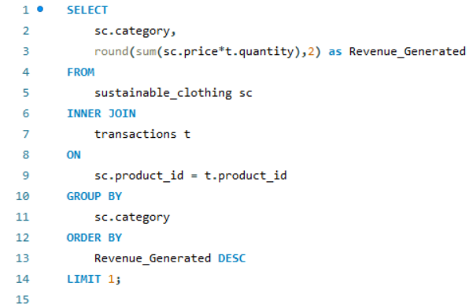

4. Category Leadership: The top-selling product category, determined by the total revenue generated, is a powerful indicator of market demand.

Slide 7
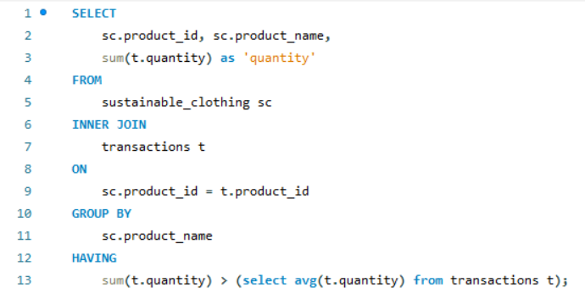
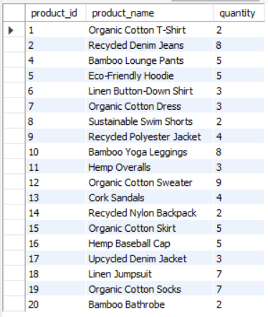
5. Standout Performers: Products that surpass the average quantity sold reveal exceptional market resonance. We're shining a spotlight on these stars.

Slide 8
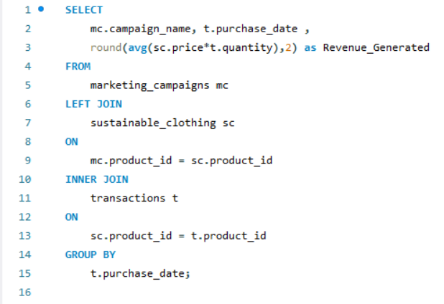
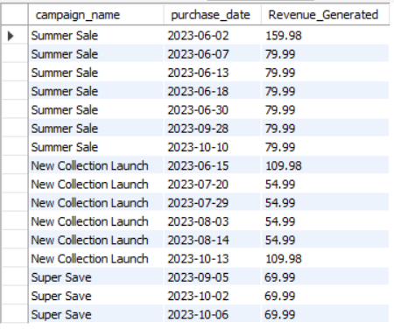
6. Daily Revenue Snapshot: To understand the daily impact of the campaigns, we're calculating the average revenue generated per day.

Slide 9
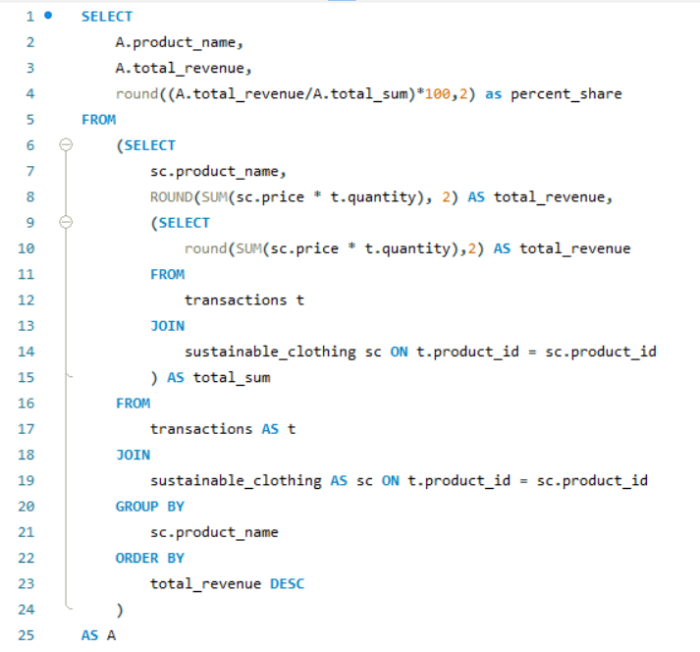
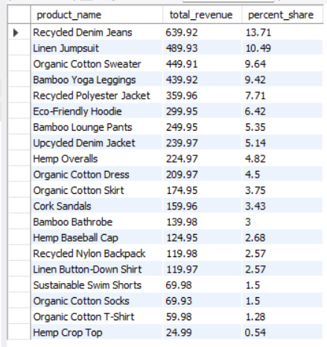
7. Contribution Analysis: Each product's percentage contribution to the total revenue unveils its individual impact on the brand's success.
Method 1 – Creating New Column ‘total_sum’

Slide 10
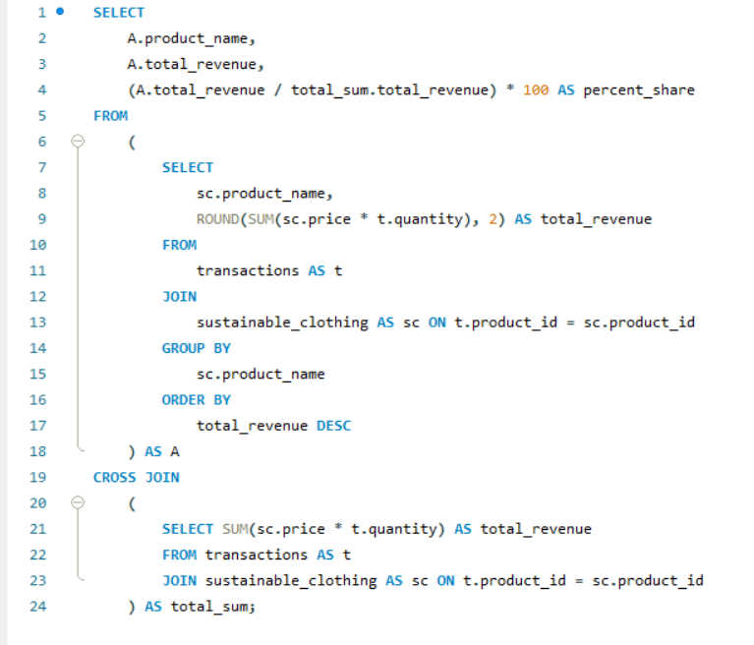
Method 2 – Using Cross Join

Slide 11
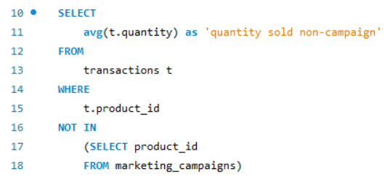
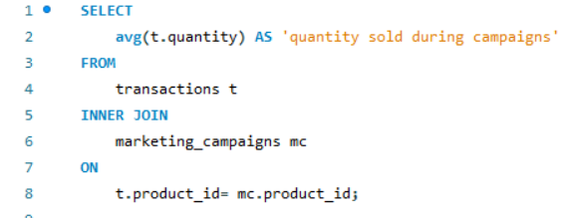


8. Comparison Challenge: A comparison of the average quantity sold during campaigns versus non-campaign periods will show us if marketing initiatives make a difference.

Slide 12
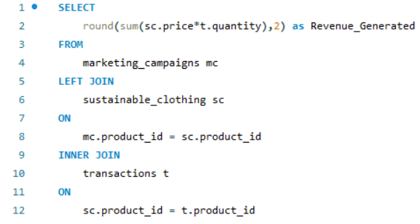
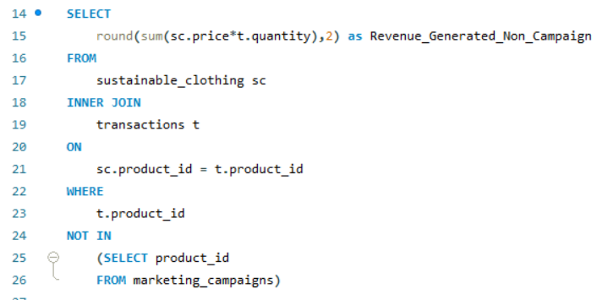


9. Campaign vs. Non-Campaign: Understanding how products perform within and outside campaigns helps tailor marketing strategies.

Slide 13
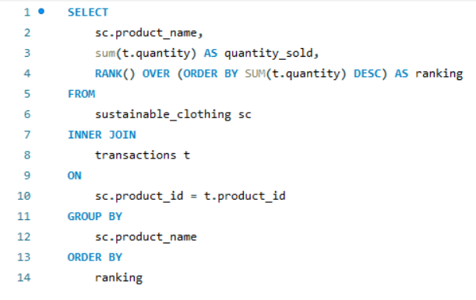
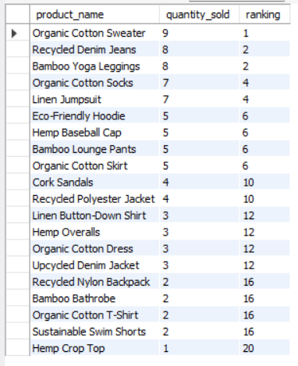
10. Top Product Rankings: Products ranked by their average daily quantity sold offer insights into customer preferences and the effectiveness of marketing efforts.

Slide 14
Conclusion
In the course of this project, I assumed the role of a data analyst, tasked with the responsibility of delving into marketing data using SQL to assist 'Sustainable Clothing Co.' – a company with a resolute commitment to harmonizing sustainability and style. Our primary goal was to conduct a comprehensive evaluation of the effectiveness of their marketing campaigns.
Throughout this project, we meticulously pored over the data, drawing out invaluable insights that not only addressed essential questions but also provided a benchmark for measuring the accomplishments of their marketing endeavors.
This journey of data exploration and analysis has served as a crucial platform for expanding my proficiency in advanced SQL concepts. I delved into the intricacies of subqueries, harnessed the power of the HAVING clause, and navigated the nuances of using operators like NOT IN. Various join methods became second nature, and the Rank() function was harnessed to gauge performance. The project also allowed me to exercise my problem-solving skills by evaluating diverse approaches to data analysis and strategy assessment.
In summary, this experience has not only enriched my SQL skill set but has also deepened my appreciation for the pivotal role of data analysis in steering the success of businesses, especially those with a sustainability-centric vision.

